Slide 1
MusicStoreDB
Re-runnable script
By
Daniel and Peter

Slide 2
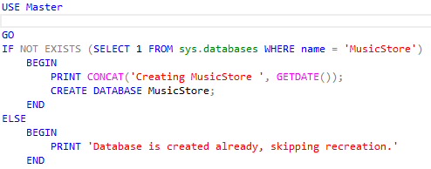
Creation of MusicStoreDB
Creates database if non existant.

Slide 3
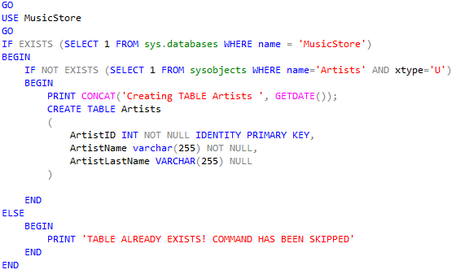
Creation of Artists table
Artists table contains ArtistName and ArtistLastName. Just in case a band is the artist, the Last name is null.

Slide 4
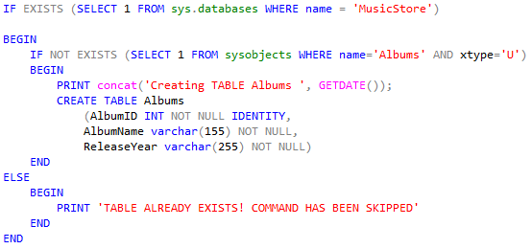
Creation of Albums table
AlbumName and ReleaseYear are needed to sort in case Albums have the same name.

Slide 5
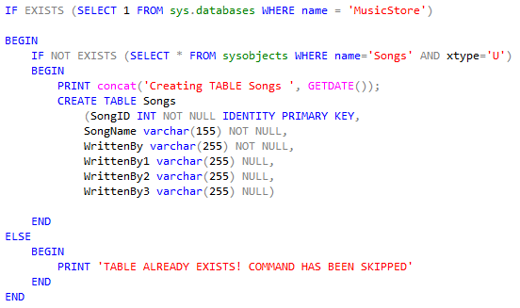
Creation of Songs Table
SongName and WrittenBy columns are incase multiple people have written a song.

Slide 6
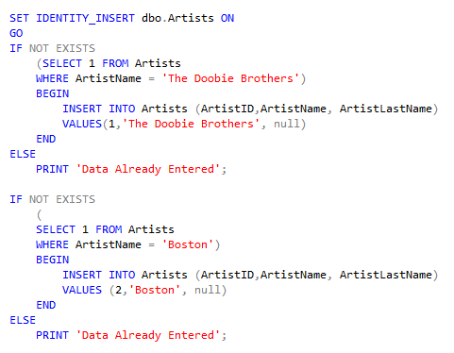
Inserting Artist data into Tables
If else for each entry in case some how one of them is deleted, they are all reentered into database table.

Slide 7
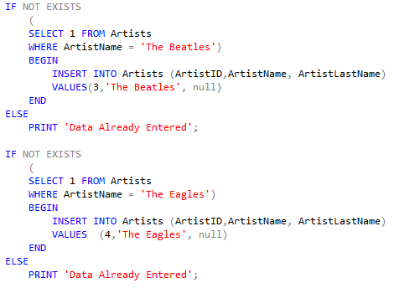

Slide 8
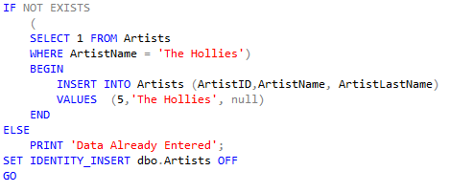

Slide 9
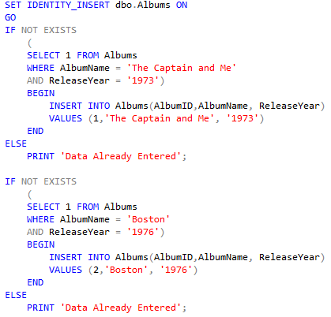
Insert Album Data into Table
Same as artists. Added extra flexibility in case a single entry isn’t there. No matter what the database table has for data it will add if it is needed.

Slide 10
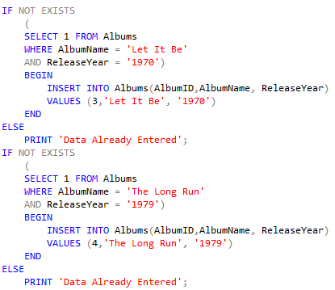

Slide 11
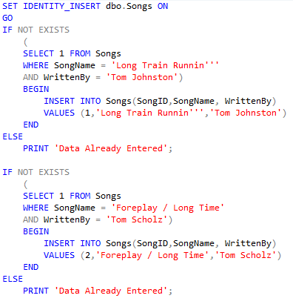
Insert Song names into Song Table and who wrote them
Same as the last two

Slide 12
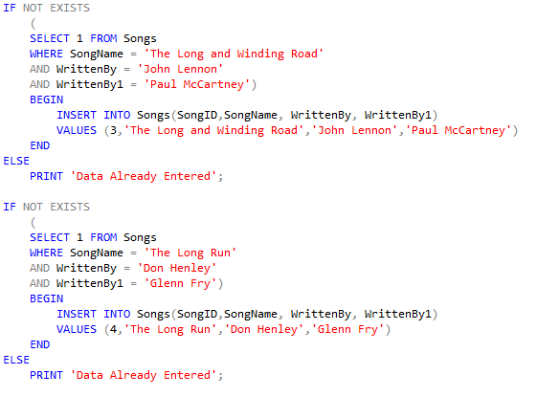

Slide 13
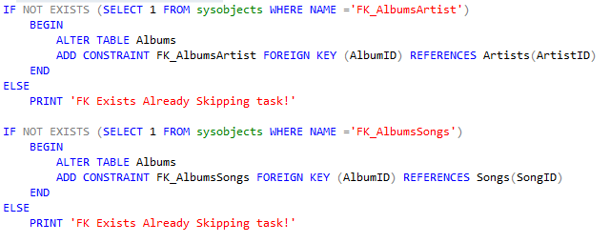
Add PK's and FK's to the tables

Slide 14
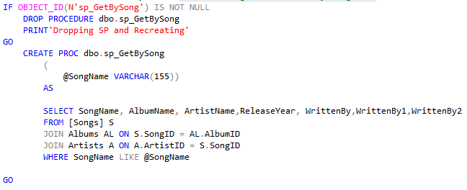
Store Procedure for searching for All info by Song Name

Slide 15
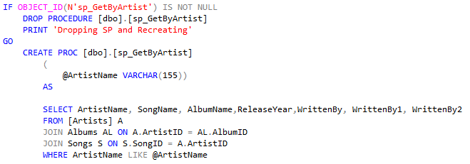
Store Procedure for search by artist

Slide 16
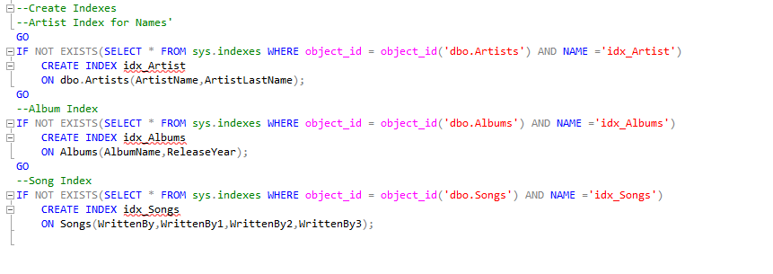
Indexes
If they do not exist then they will be made. This was the only solution I found to work. It could be expanded to drop and remake. It was made to match the rest of the script file. If it was a real situation I do not see the point of deleting the DB when it exists.

